Slide 1
File Replication
Ngo Huy Bien
Software Engineering Department
Faculty of Information Technology
VNUHCM - University of Science
Ho Chi Minh City, Vietnam
nhbien@fit.hcmus.edu.vn

Slide 2

References
Ludmila Cherkasova and Jangwon Lee (2003). FastReplica - Efficient Large File Distribution Within Content Delivery Networks.
KyoungSoo Park and Vivek S. Pai (2004). Deploying Large File Transfer on an HTTP Content Distribution Network.
KyoungSoo Park and Vivek S. Pai (2006). Scale and Performance in the CoBlitz Large-File Distribution Service.

Slide 3
Problem Statement [1]
Let N₀ be a node which has an original file F and let Size(F) denote the size of file F in bytes.
Let R = {N₁, ...,N_{n}} be a replication set of nodes.
The problem consists in replicating file F across nodes N₁, ...., N_{n} while minimizing the overall replication time.

Slide 4
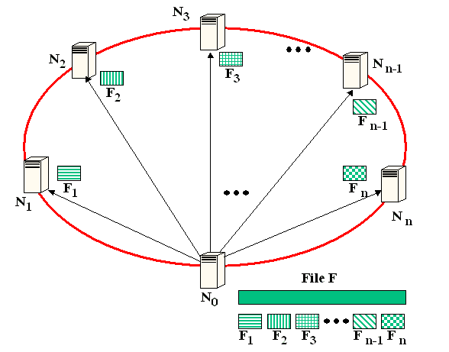
FastReplica in the Small – Distribution Step
The originator node N₀ opens n concurrent network connections to nodes N₁, ..., N_{n}, and sends to each recipient node N_{i} (1 ≤ i ≤ n) the following items:
a distribution list of nodes R = {N₁, ...,N_{n}} to which subfile F_{i} has to be sent on the next step;
subfile F_{i}.

Slide 5
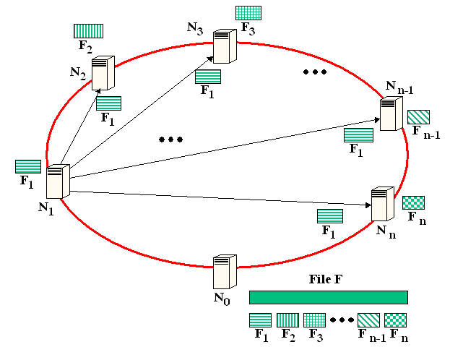
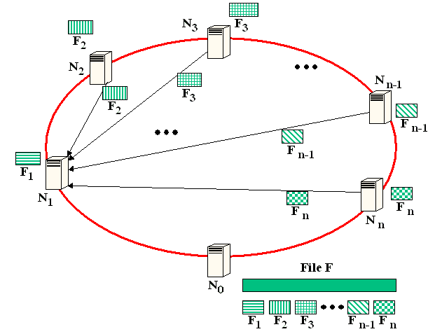
Collection Step
After receiving file F_{i}, node Ni opens n−1 concurrent network connections to remaining nodes in the group and send subfile F_{i} to them.

Slide 6
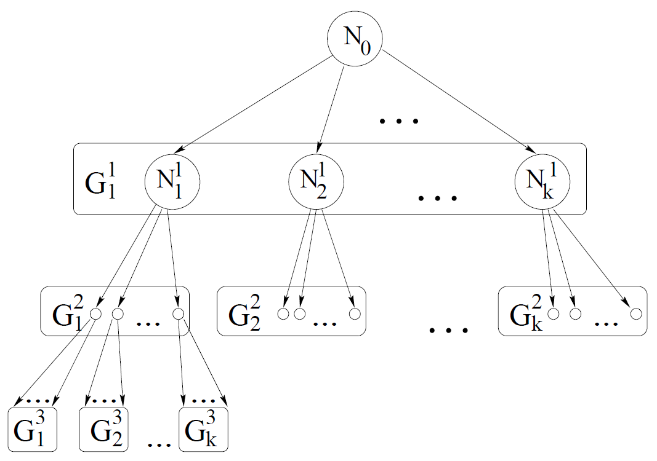
FastReplica in the Large
partition the original set of nodes into replication groups, each consisting of k nodes
apply FastReplica in the small iteratively: first, replicate the original file F to a group of k nodes, and then use these k nodes as the origin nodes with file F to repeat the same procedure to a new groups of nodes, etc.

Slide 7
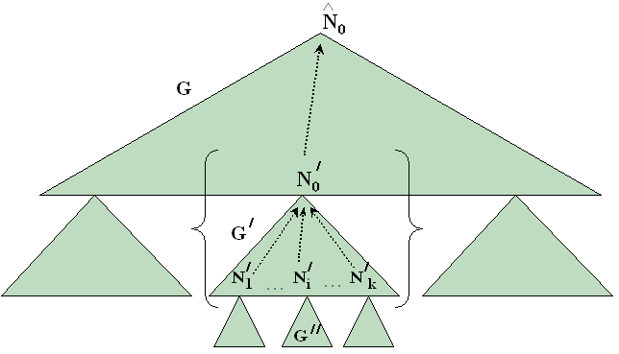
Reliable FastReplica Algorithm
In reliable FastReplica, the nodes of each group are exchanging the heartbeat messages with their origin node.
The heartbeat messages from nodes to their origin node are augmented with additional information on the corresponding algorithm step and group (list) of nodes to which the nodes currently perform their transfers.

Slide 8
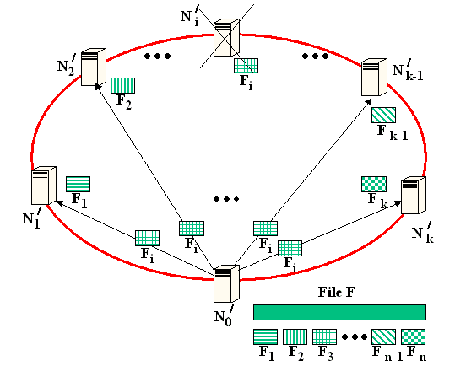
Repair Procedure (I)
Repair procedure for node N_{i} failed during distribution step

Slide 9
Repair Procedure (II)
If node N_{i} fails while acting as a recipient node in replication set G’ during the collection step then using the heartbeat messages, the failure of node N_{i} is detected by node N₀. N₀ opens connections to the impacted nodes in group G’ to send missing file F_{i}

Slide 10
Repair Procedure (III)
If node N₀ fails while acting as the origin node for replication group G’ during the distribution step then replication group G should be “reattached” to a higher-level origin node (i.e. Nˆ₀).
From heartbeat messages, node Nˆ₀ detects node N’₀ failure.
Node Nˆ₀ analyzes what was the node N’₀ state in the replication process preceding its failure.
Then node Nˆ₀ acts as a replacement for N’₀:

Slide 11
Experiments on a Prototype Implementation
For comparison reasons, we introduce Multiple Unicast and Sequential Unicast schemas.
Multiple Unicast: under this scheme, the original node simultaneously transfers the entire file to all the recipient nodes by using the concurrent connections.
Sequential Unicast: this scheme approximates the “best possible overlay tree” for the entire set of group members. For the evaluation, we use the Sequential Unicast test which measures the file transfer time from the source to each recipient independently (i.e. in the absence of other recipients).

Slide 12


Slide 13
Large Files Problems [2]
Large files tax the CDN node’s most valuable resource, physical memory.
Cache hit rates: Large files displace small files in main memory. As a result, proxies generally “tunnel” such small files, fetching them from the origin site and not caching them. The CDN/proxy would require much higher hit rates.
Buffer consumption: While multiple client requests for the same uncached file can often be merged and served with one download from the origin server, doing so for large files requires the proxy to buffer all data not received by the slowest client, potentially approaching the entire file size. This buffer either pollutes the cache and consumes memory, or causes disk access and eviction. Throttling the fastest client to reduce the buffer size only makes the CDN slow and increases the number of simultaneous connections.

Slide 14
Custom Protocols
BitTorrent implements a peer-to-peer network with centralized tracking of available clients.
LoCI builds a stateful, filesystem-like network infrastructure.
Bullet uses a self-organizing overlay mesh.
SplitStream has a superimposed collection of multicast trees on a peer-to-peer overlay.
All of these approaches use (or will use, when deployed) custom protocols for data transfers.
They require content preparation at the content provider, and custom software at the receivers.

Slide 15
Approach
Each CDN node has an agent that is responsible for accepting requests for large files and converting them into a series of requests for pieces of the file.
To specify pieces, we use HTTP/1.1’s widely-supported byte-range feature, which is normally used by browsers to resume interrupted downloads.
After these individual requests are injected into the CDN, the results are reassembled by the agent and passed to the actual client.
For simplicity, this agent can occupy a different port number than the CDN’s proxy.

Slide 16
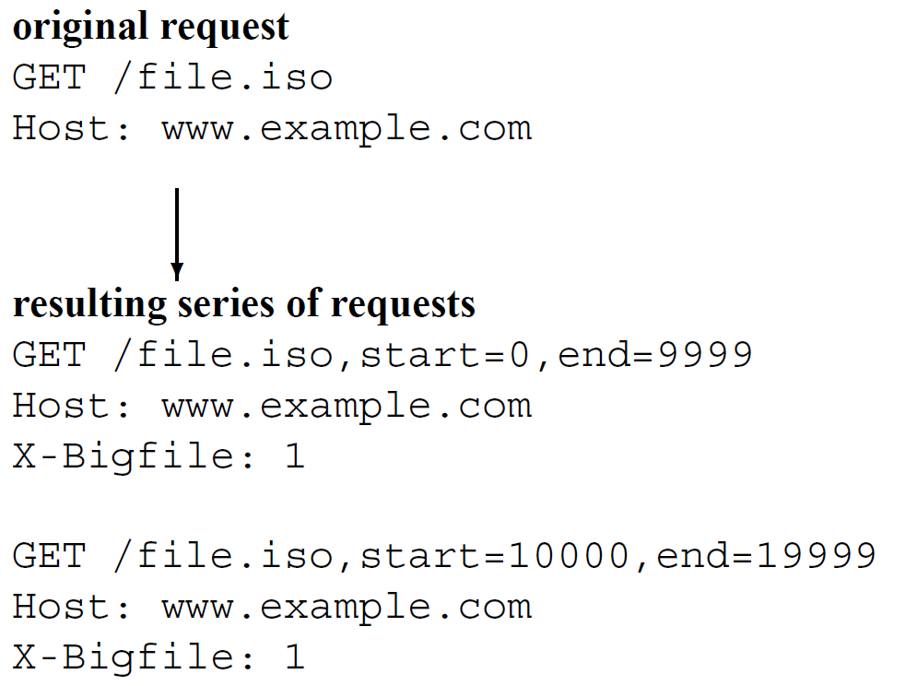
Byte-Range Feature [3]
The client-facing agent converts a single request for a large file into a series of requests for smaller files.
The new URLS are only a CDN-internal representation – neither the client nor the origin server see them.

Slide 17
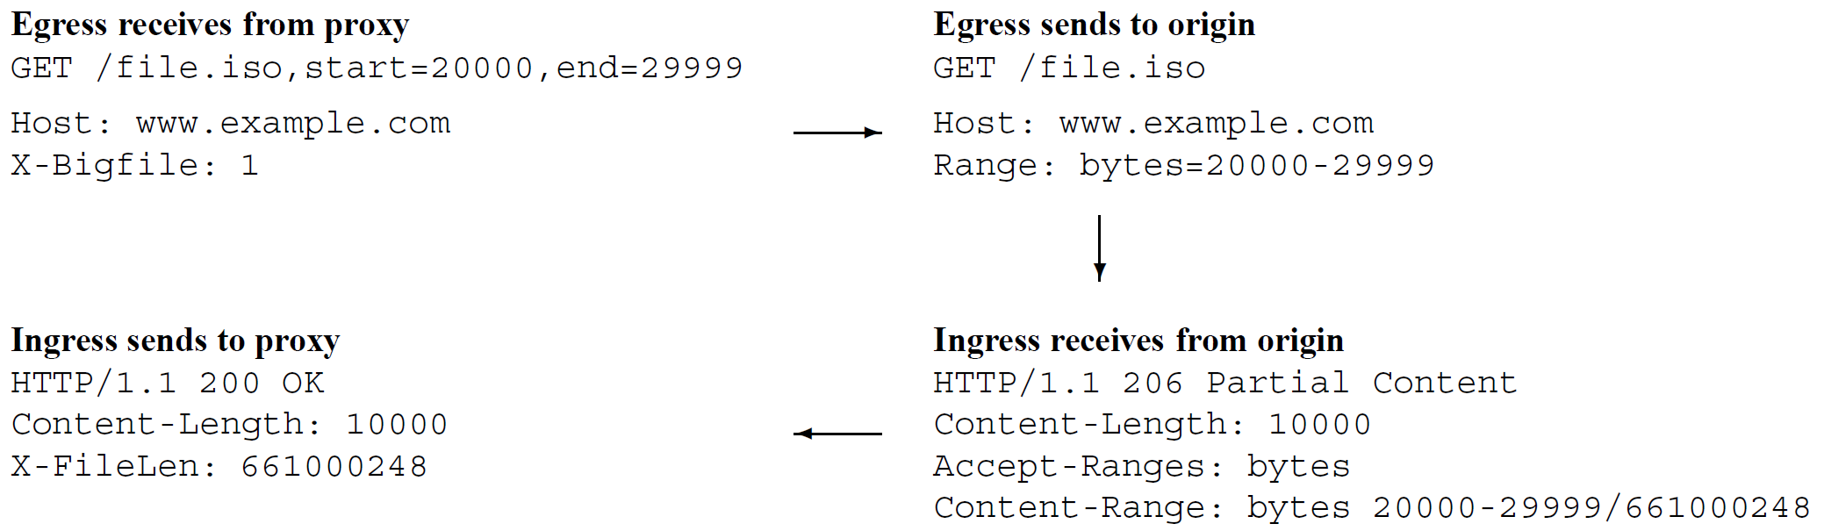
Chunk Handling Mechanics
Egress and ingress transformations when the CDN communicates with the origin server:
The CDN internally believes it is requesting a small file, and the egress transformation requests a byte-range of a large file.
The ingress converts the server’s response to a response for a complete small file, rather than a piece of a large file.

Slide 18
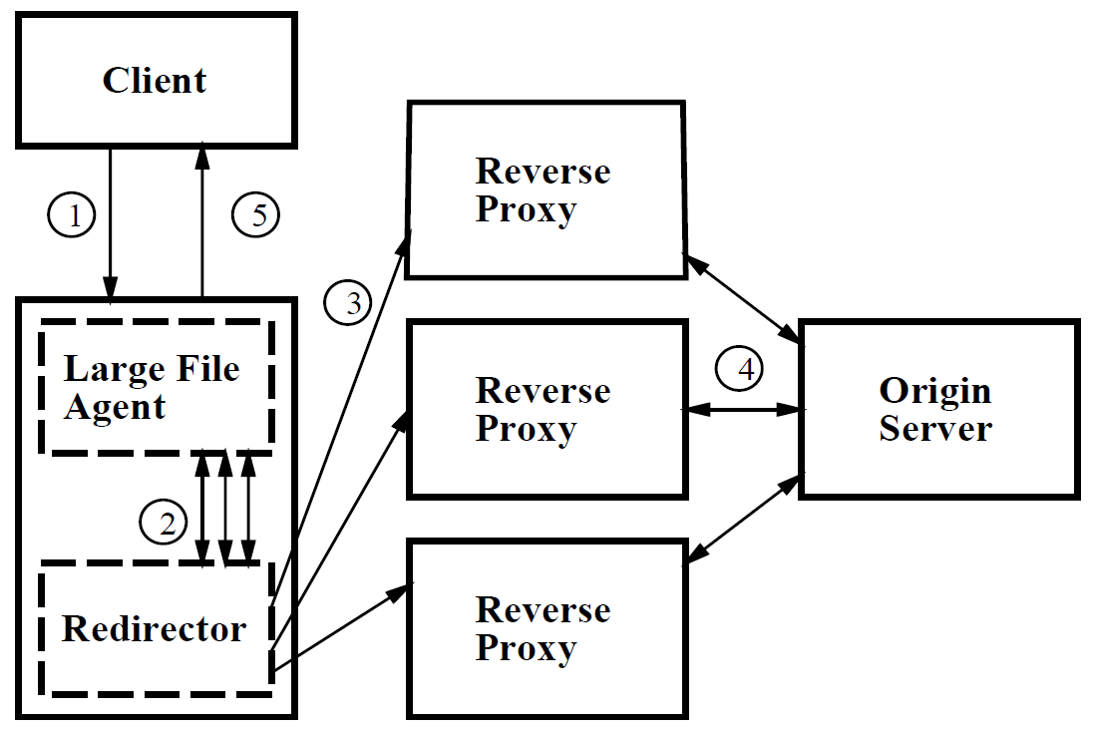
Processing Steps
1. the client sends the request to the agent,
2. the agent generates a series of requests for the URL with special suffixes and sends them to the redirector on the same CDN node,
3. those requests are spread across the CDN as normally occurs,
4. on egress from the CDN (assuming cache misses), the URLs are de-mangled, and the response header is mangled to mimic a regular response,
5. as the data returns to the agent, it sends it back to the client in order, appearing as a single large response

Slide 19

Thank You & See You Again

